Slide 1
DEPARTMENT OF CSE, CSIT
COURSE NAME – FUNDAMENTALS OF DATA ENGINEERING
COURSE CODE – 24DEA3101
FOODFLOW -
End-to-End Food Delivery Data Engineering & Analytics Platform
Under the guidance of Dr.N.Shirisha
Associate Professor
Team Members:
T.K.Amulya - 2420030434
Sahasra - 2420090128
Jithyasri.S - 2420030586

Slide 2
ABSTRACT:
Food delivery platforms generate large volumes of data from customer, restaurant, order, payment, delivery, and review systems. Since these sources produce data in different formats and at different frequencies, integrating and analyzing them efficiently is challenging. FoodFlow is an end-to-end Data Engineering platform that integrates these heterogeneous sources through batch and optional streaming ingestion, followed by data cleaning, validation, transformation, and dimensional modeling. The processed data is stored in a structured data warehouse and used to derive insights such as revenue, order trends, delivery time, cancellation rates, and restaurant performance. An interactive dashboard presents these insights for effective analysis. The platform is implemented incrementally using Python and PostgreSQL, with integration of Apache Kafka, Apache Spark, and Apache Airflow for real-time ingestion, large-scale processing, and workflow orchestration. An interactive dashboard provides decision-ready insights from the processed data. Overall, FoodFlow demonstrates the complete Data Engineering lifecycle from heterogeneous source systems to reliable, structured, and analytics-ready information.

Slide 3
INTRODUCTION:
Existing food-delivery platforms primarily focus on customer ordering, restaurant discovery, payments, and delivery services. While these platforms already use advanced data infrastructure internally, our project does not aim to replicate their applications. Instead, FoodFlow focuses specifically on the Data Engineering layer behind a food-delivery ecosystem.
The key challenge is that customer, restaurant, order, payment, delivery, and review data are generated by independent systems with different formats, schemas, and update frequencies. FoodFlow addresses this fragmentation by providing a unified platform for integrating these heterogeneous datasets, improving data quality, and making the data consistent and analytics-ready.
Unlike a basic food-delivery database or dashboard project, FoodFlow emphasizes data quality, multi-source integration, batch and streaming ingestion, layered storage, dimensional modeling, and scalable processing. The improved system enables cross-domain analysis such as identifying relationships between restaurant performance, delivery efficiency, customer behavior, cancellations, and revenue. Thus, the project demonstrates how raw data from a food-delivery ecosystem can be transformed into reliable and decision-ready information without attempting to build another food-delivery application.

Slide 4
A unified food-delivery data platform integrating heterogeneous data from multiple sources.
Reliable and analytics-ready data with improved consistency and quality.
Successful classification of integrated data using Random Forest.
Identification of meaningful patterns and trends across customers, restaurants, orders, payments, and deliveries.
Interactive dashboards with key insights and KPIs for understanding food-delivery performance.
A decision-support system that enables data-driven analysis and provides a foundation for future predictive analytics.

Slide 5

LITERATURE SURVEY
Paper type • Core contribution • Drawback • Future-work implication
ID | Paper | Link | Core contribution | Drawback | Future work / FoodFlow implication
P01 | Data-driven optimization for last-mile delivery | https://link.springer.com/article/10.1007/s40747-021-00293-1 | Multi-source data + machine learning + vehicle-routing optimization. | Operational optimization is the main focus; end-to-end data engineering is not the core contribution. | Build reusable ingestion, validation, warehouse and orchestration layers for downstream optimization.
P02 | A Predictive Data Analytics Methodology for Online Food Delivery | https://doi.org/10.1109/SNAMS58071.2022.10062613 | Systematic KPI analysis using classification and regression; Random Forest performed strongly in the case study. | Prediction-centric methodology; production-scale ingestion and workflow orchestration are outside the main scope. | Connect KPI prediction to governed pipelines, scalable processing and automated data-quality checks.
P03 | Enhancing Online Food Delivery Systems through Comprehensive Text Analytics and Strategic Data Integration | https://doi.org/10.1109/SNAMS58071.2022.10062613 | Combines text, web, social, stream and geospatial analytics with strategic data integration. | Broad analytics scope; less emphasis on a structured Data Engineering lifecycle and warehouse model. | Strengthen multi-source ingestion, data contracts, dimensional modeling and orchestration.
P04 | Knowledge-informed dynamic graph neural network for restaurant-level demand prediction in online food delivery | https://doi.org/10.1016/j.trc.2026.105634 | Restaurant-level demand prediction using dynamic graphs, spatial-temporal attention and domain knowledge. | Advanced ML assumes analytics-ready data; upstream pipeline engineering is not the main problem addressed. | Provide governed feature-ready data from a warehouse or lakehouse for predictive models.
P05 | A Sageformer-KAN deep learning model for demand prediction of online food deliveries | https://doi.org/10.1016/j.ijtst.2025.10.005 | Combines graph neural networks, Transformer temporal encoding and KAN for spatiotemporal demand forecasting. | Strong predictive architecture but focused on forecasting rather than ingestion, quality and orchestration. | Integrate forecasting models with real-time streaming and curated analytical data products.
6

Slide 6
LITERATURE SURVEY
ID | Paper | Type | Core contribution | Drawback | Future work / FoodFlow implication
P06 | A Deep & Cross Network-based framework for online food delivery time prediction with driver-specific information | https://doi.org/10.1016/j.omega.2025.103457 | Uses driver-specific information, Deep & Cross Network feature interactions and real-world Zomato data for delivery-time prediction. | Driver data can be sparse, dispersed and privacy-sensitive; feature engineering is model-centric. | Add governed driver/delivery data integration, lineage and privacy-aware feature pipelines.
P07 | Online food delivery companies' performance and consumers expectations during Covid-19: An investigation using machine learning approach | https://doi.org/10.1016/j.jretconser.2022.103052 | Uses social-media big data, machine learning, topic modeling and sentiment analysis to study OFD performance. | Social-media analytics is valuable but does not provide a unified transactional data platform. | Integrate transactional, review and social data into a common analytical model.
P08 | Modeling the online food delivery pricing and waiting time: Evidence from Davis, Sacramento, and San Francisco | https://doi.org/10.1016/j.trip.2023.100891 | Analyzes delivery fees, distance, demand-supply conditions and waiting time across locations. | Study is empirical and location-specific; limited focus on reusable pipeline architecture. | Build standardized location, pricing and delivery-time datasets for scalable cross-market analytics.
P09 | The online food delivery problem on stars | https://doi.org/10.1016/j.tcs.2022.06.007 | Formalizes online food-delivery dispatching and analyzes competitive strategies for serving requests. | Primarily theoretical; does not address data ingestion, storage or operational analytics pipelines. | Use operational event data to support real-time dispatch analytics and experimentation.
P10 | Factors affecting customer intention to use online food delivery services before and during the COVID-19 pandemic | https://doi.org/10.1016/j.jhtm.2021.08.01 | Studies usefulness, ease of use, price/time benefits, safety risk and trust as predictors of OFD usage intention. | Customer-intention focus; does not integrate operational, transactional and delivery datasets. | Combine customer behavior with order, payment, restaurant and delivery facts for end-to-end analytics.
7

Slide 7
PROPOSED SOLUTION
FoodFlow is an end-to-end food-delivery data engineering platform designed to integrate data from multiple food-delivery systems and convert it into clean, reliable, analysis-ready information.
Core Capabilities
Multi-Source Data Ingestion
Collects data from customer, restaurant, order, payment, delivery, and review systems.
Batch & Real-Time Processing
Processes both historical datasets and continuously generated order and delivery events.
Data Quality Management
Handles missing values, duplicate records, invalid entries, inconsistent formats, and schema issues.
Data Transformation & Integration
Cleans, joins, standardizes, and transforms data from different source systems into a unified format.
Scalable Data Storage
Stores raw and processed data using a data lake and structured data warehouse.
Data Modeling
Organizes integrated data using a star schema for efficient analytical queries.
Food-Delivery Analytics
Analyzes sales, customer behavior, restaurant performance, order trends, payment patterns, and delivery efficiency.
Interactive Visualization
Provides meaningful business insights through interactive dashboards for monitoring and decision-making.

Slide 8
TECHNOLOGY STACK
Programming & Development
Python • Git • GitHub
Data Ingestion
CSV/JSON • Python • Apache Kafka
Data Processing & Transformation
Apache Spark
Data Quality
Great Expectations
Data Storage
MinIO • Apache Parquet • PostgreSQL
Data Modeling
SQL • Star Schema
Workflow Orchestration
Apache Airflow
Analytics & Visualization
SQL • Power BI
Containerization
Docker

Slide 9
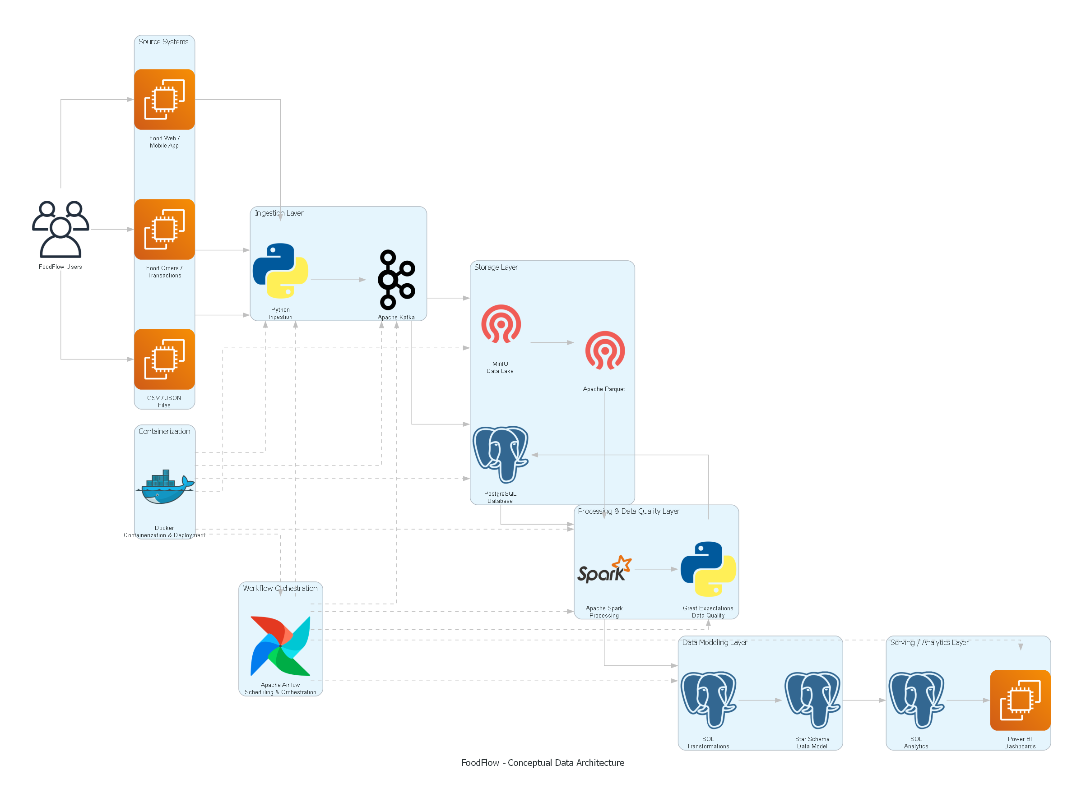
METHOD FLOW

